Slide 1
Quantum KNN experiment
10/04/2021

Slide 2
1. Swaptest [8/2006] between 2 complex vectors

Slide 3
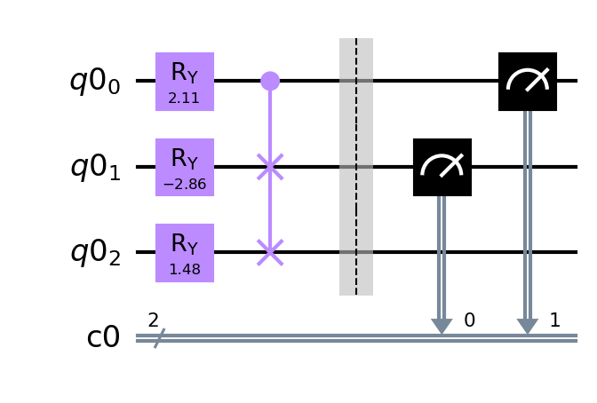
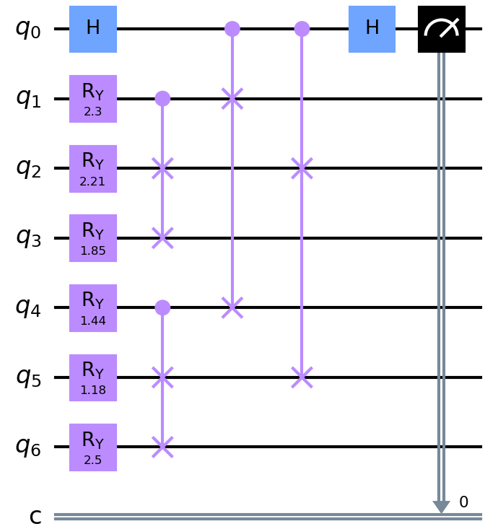






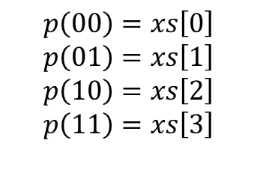


Encode one vector
(load data into circuit)
xs = [1 0 2 3]
xs = [$\frac{1}{\sqrt{14}} 0\frac{2}{\sqrt{14}}\frac{3}{\sqrt{14}}$]
Vector
Normalize
Quantum state
$p_{v_{1}}(1)$
$p_{v_{1}}(0)$
$$p\left(00\right)=xs\left[0\right]$$
$$p\left(01\right)=xs\left[1\right]$$
$$p\left(10\right)=xs\left[2\right]$$
$$p\left(11\right)=xs\left[3\right]$$
Encode $v_{1}$
Combine with swap test
$p_{v_{2}}(1)$
$p_{v_{2}}(0)$
Encode $v_{2}$
$p_{q_{0}}$

Slide 4
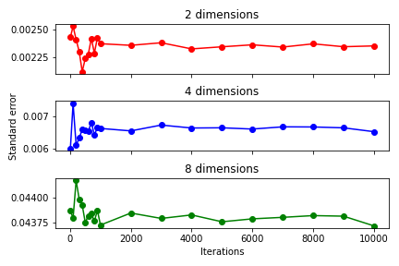
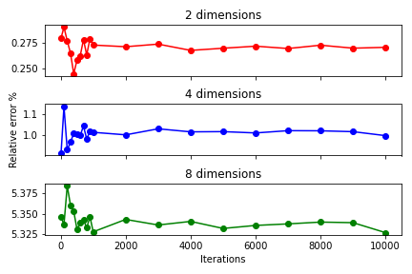
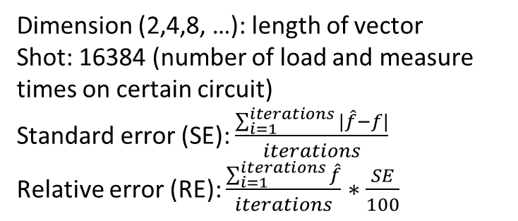
Dimension (2,4,8, …): length of vector
Shot: 16384 (number of load and measure times on certain circuit)
Standard error (SE): $\frac{\sum_{i=1}^{iterations}{|\hat{f}−f|}}{iterations}$
Relative error (RE): $\frac{\sum_{i=1}^{iterations}{\hat{f}}}{iterations}∗\frac{SE}{100}$

Slide 5
2. New QKNN

Slide 6
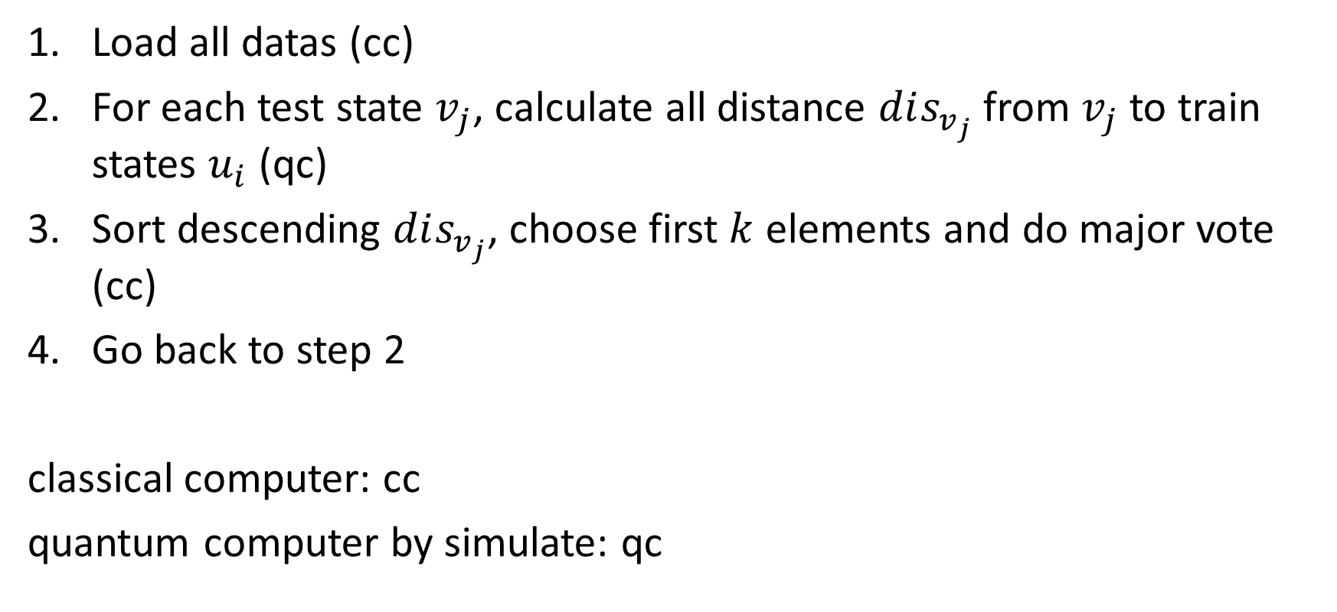
2. Algorithm
Load all datas (cc)
For each test state $v_{j}$, calculate all distance $dis_{v_{j}}$ from $v_{j}$ to train states $u_{i}$ (qc)
Sort descending $dis_{v_{j}}$, choose first $k$ elements and do major vote (cc)
Go back to step 2
classical computer: cc
quantum computer by simulate: qc

Slide 7
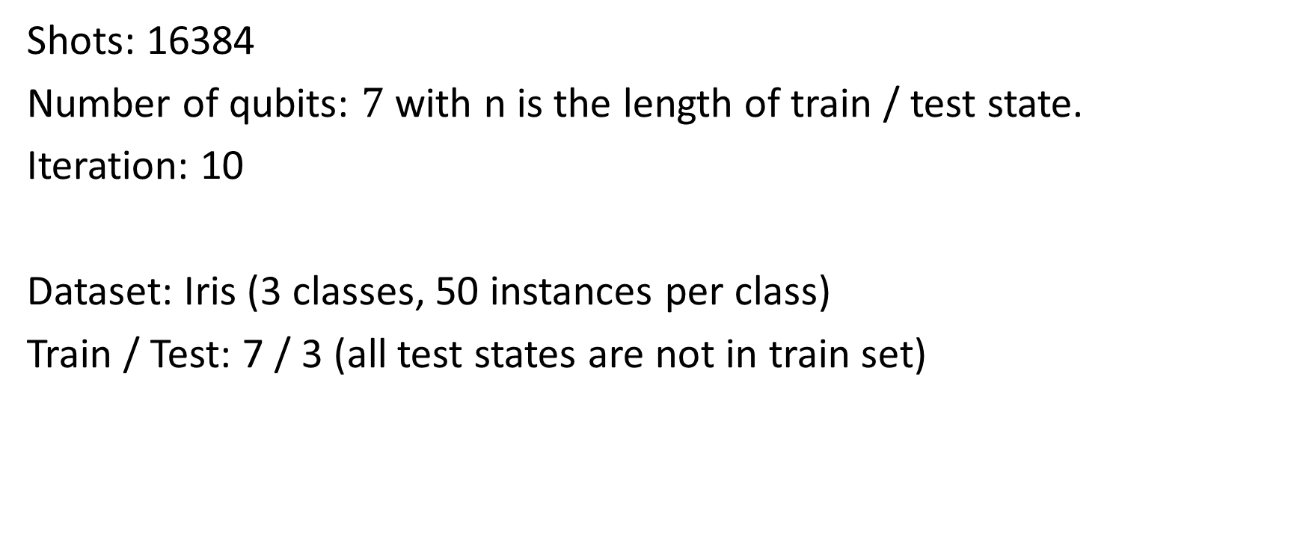
3. Experiments
Shots: 16384
Number of qubits: $7$ with n is the length of train / test state.
Iteration: 10
Dataset: Iris (3 classes, 50 instances per class)
Train / Test: 7 / 3 (all test states are not in train set)

Slide 8
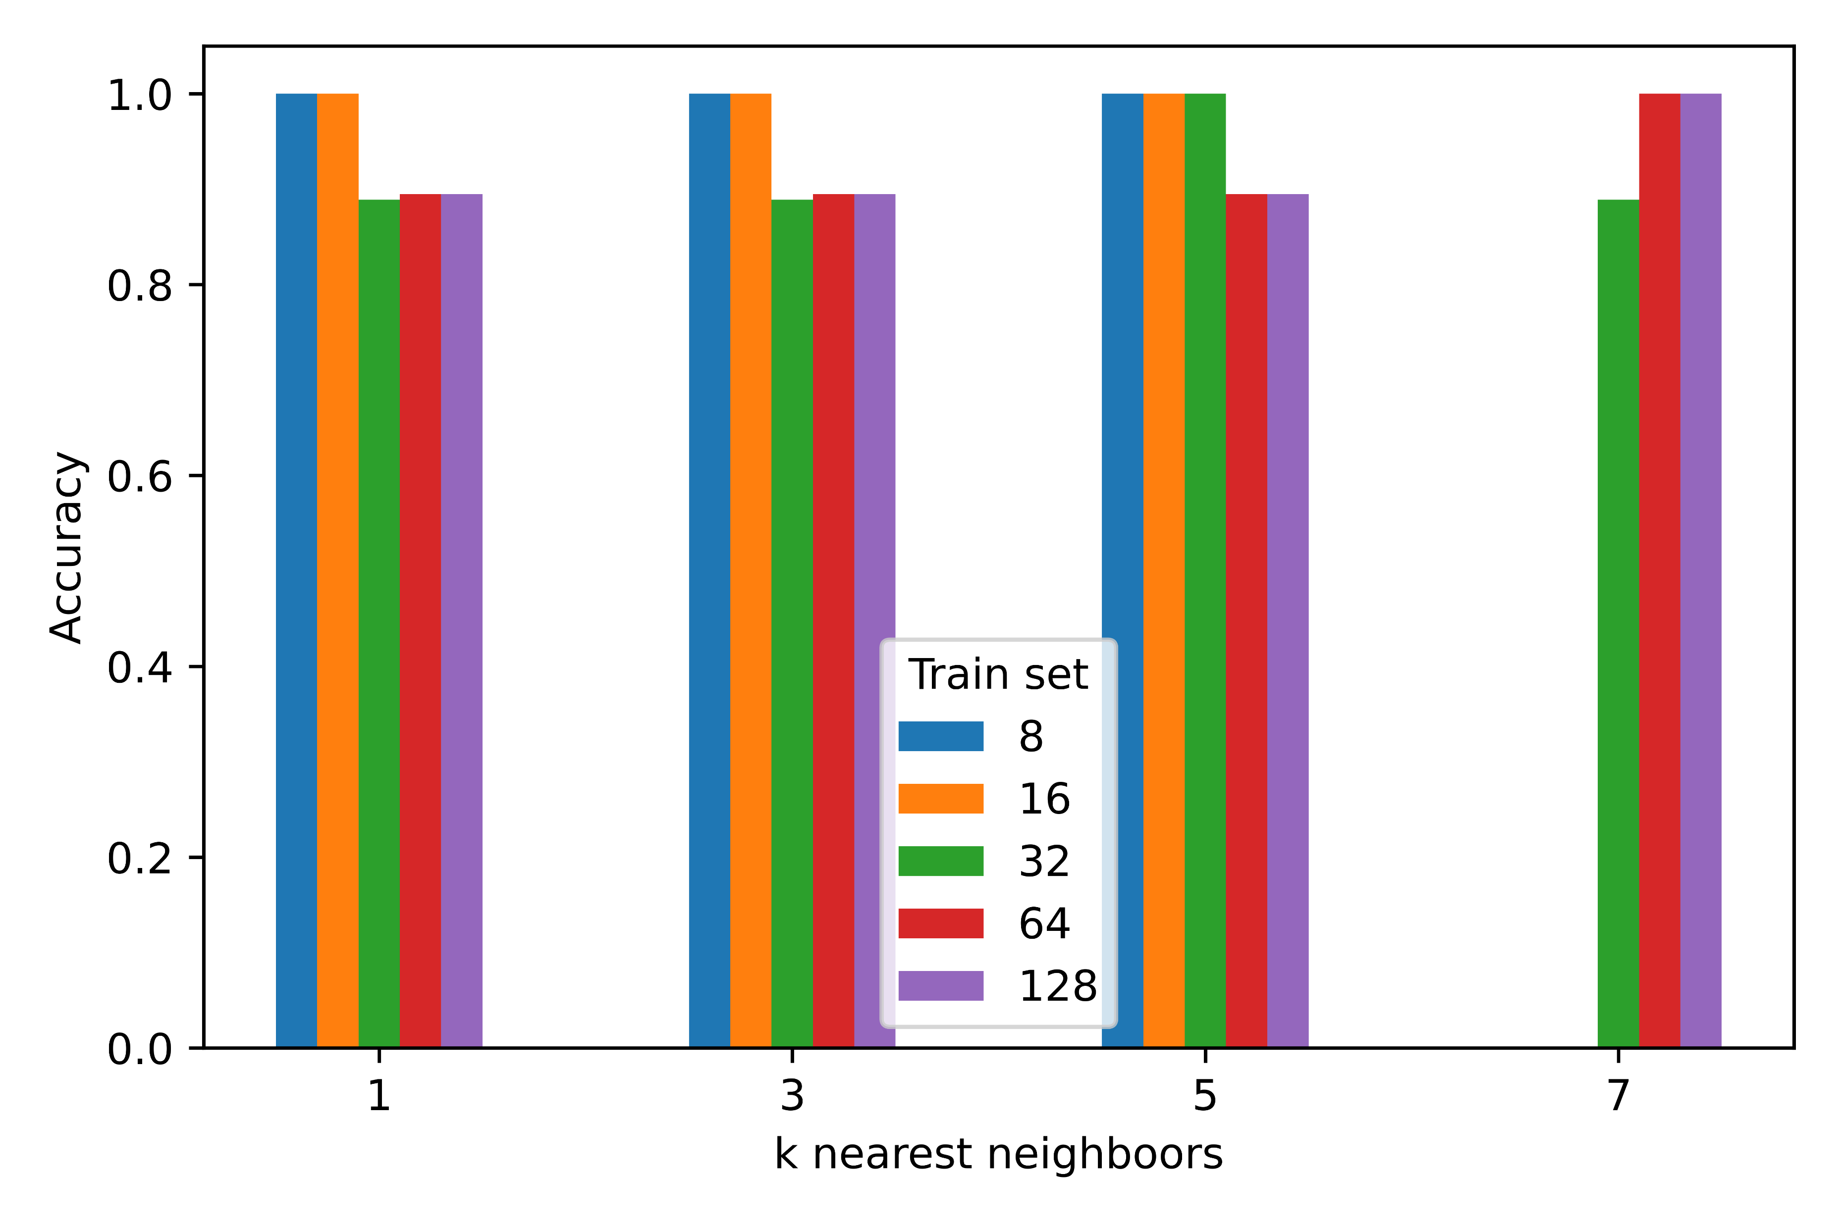
3.1. Accuracy

Slide 9



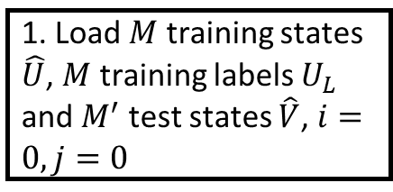




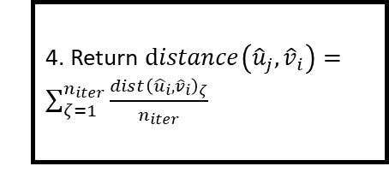







Classical computer
Quantum computer
1. Load $M$ training states $\hat{U}$, $M$ training labels $U_{L}$ and $M^{′}$ test states $\hat{V}$, $i=0,j=0$
2. Create integrated swap test circuit for $u_{j}$in $\hat{U},$ ${\hat{v}}_{i}$ in $\hat{V}$, $ζ=0$
$$F$$
$$F$$
5. Append $dist\left({{\hat{u}}_{j},\hat{v}}_{i}\right)$ into list $distances_{v_{i}}$, increase $j$ by one unit
Begin
$$j=M$$
3. Calculate $distance{\left({\hat{u}}_{j},{\hat{v}}_{i}\right)}_{ζ}$, increase $ζ$ by one unit
$$i=M^{′}$$
$$T$$
$$T$$
6. Sort descending $distances_{v_{i}}$ and choose first $k$ elements
End
$$F$$
$$ζ=n_{iter}$$
$$T$$
7. Label ${\hat{v}}_{i}$by majority voting with training labels $U_{L}$, increase $i$ by one unit
4. Return $distance\left({{\hat{u}}_{j},\hat{v}}_{i}\right)=\sum_{ζ=1}^{n_{iter}}{\frac{dist{\left({{\hat{u}}_{i},\hat{v}}_{i}\right)}_{ζ}}{n_{iter}}}$

